Slide 1
Meeting 17.10.2016

Slide 2
Expect grade
Jiaqi Ni | 8.5
Kalina Petrova | 8.5
Wen Zhang | 8.5
Jianfei Feng | 7.0
Mengchuan Liu | 8.0
Jiefan Lin | 8.0

Slide 3
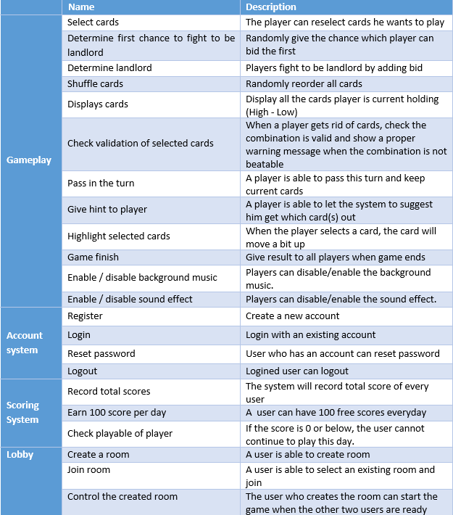
Use cases

Slide 4
MOSCOW
Must
Join room
Select cards
Determine first chance to fight to be landlord
Determine landlord
Shuffle cards
Display cards
Check validation of selected cards
Pass in the turn
Give hints to player
Highlight selected cards
Record total scores

Slide 5
MOSCOW
Should
Register
Login
Logout
Check playable of player

Slide 6
MOSCOW
Could
Reset password
Create a room
Control the create room
Enable / disable background music
Enable / disable sound effect

Slide 7
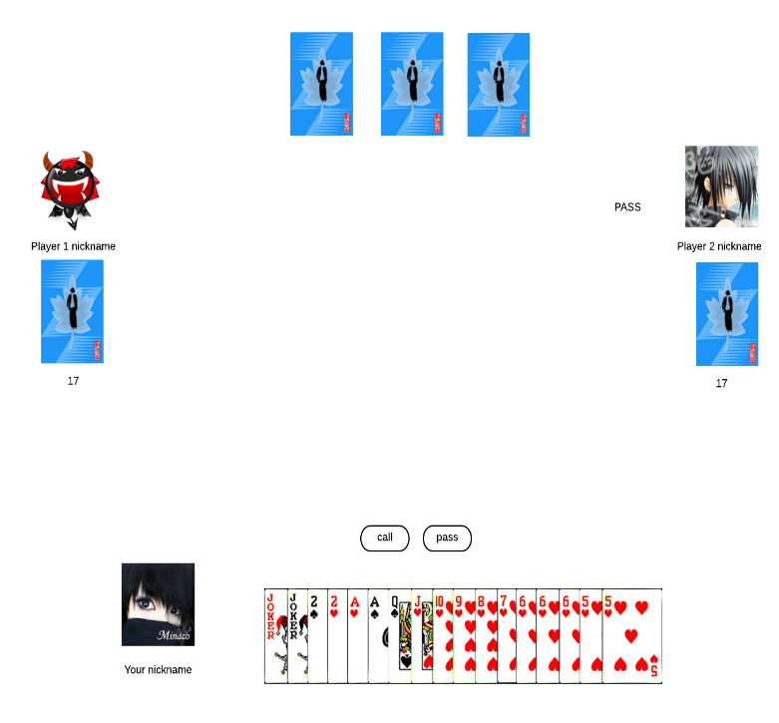
Determine the landlord

Slide 8
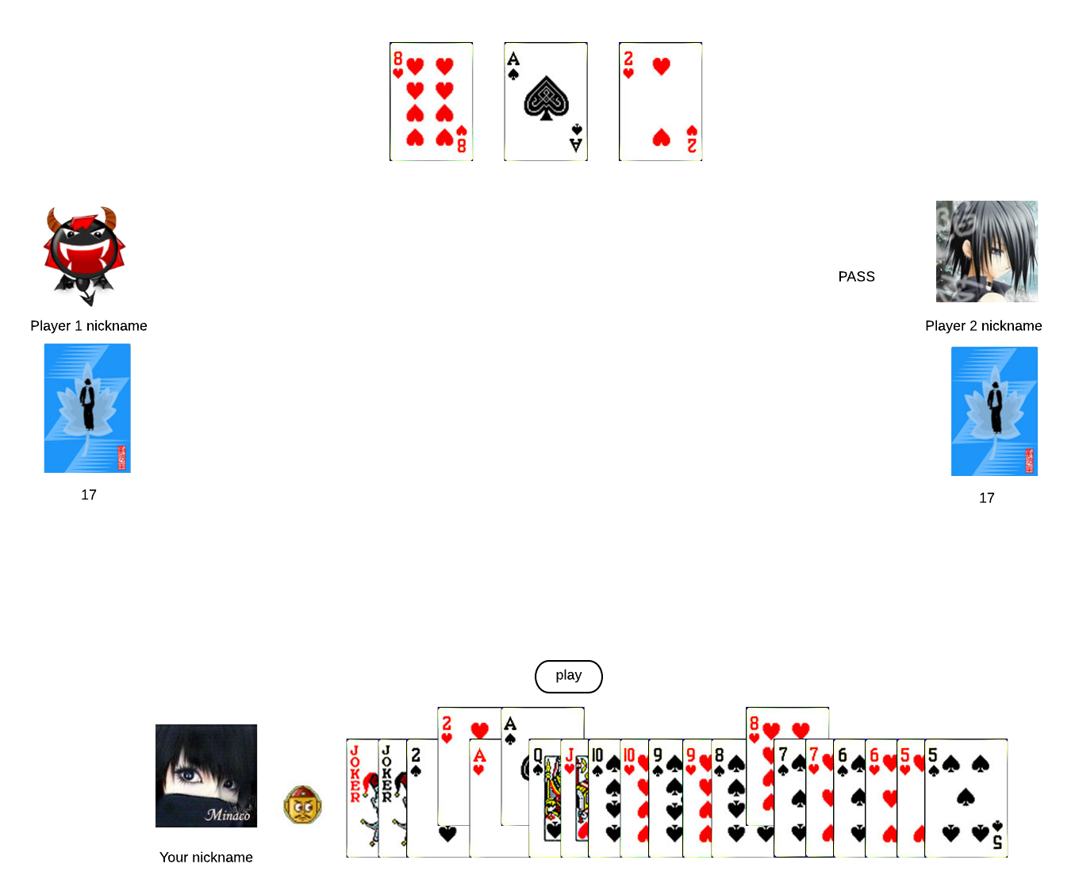
Give leftover cards to landlord

Slide 9
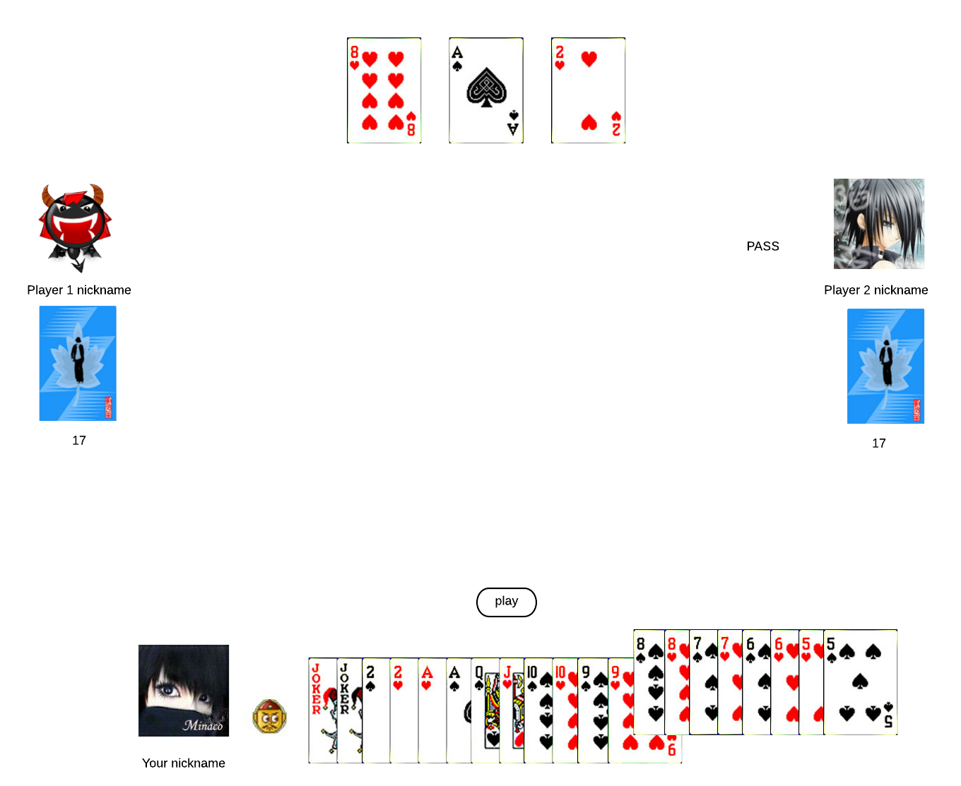
Select cards

Slide 10
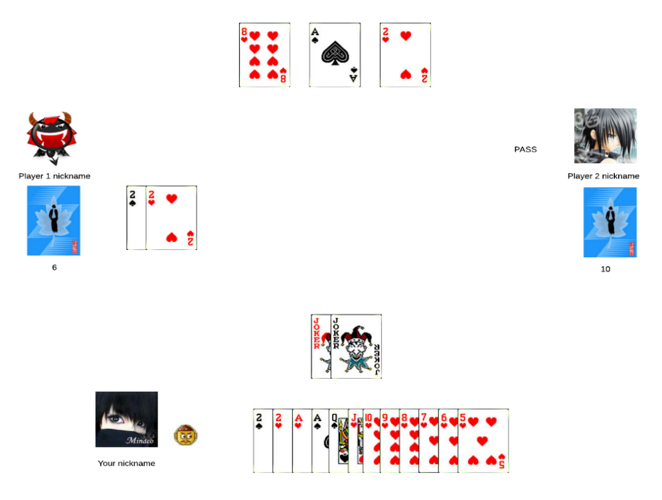
Hand over cards

Slide 11
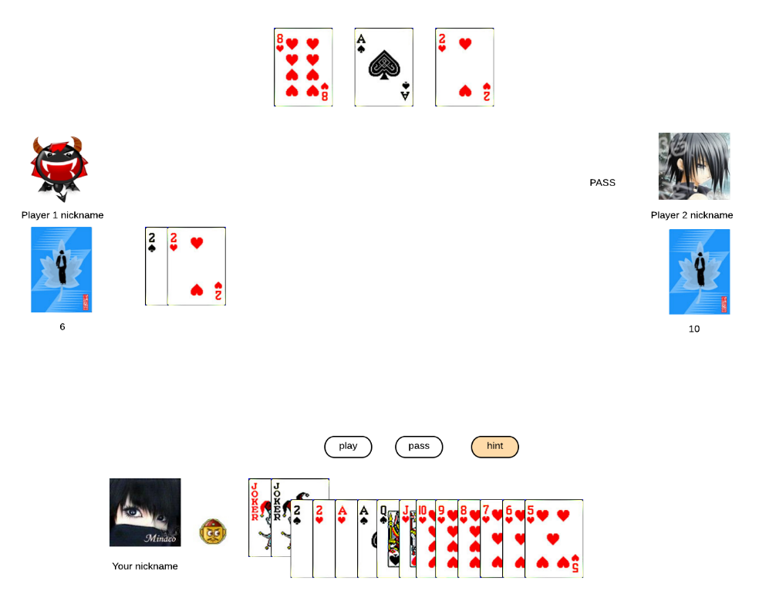
Give hints to player

Slide 12
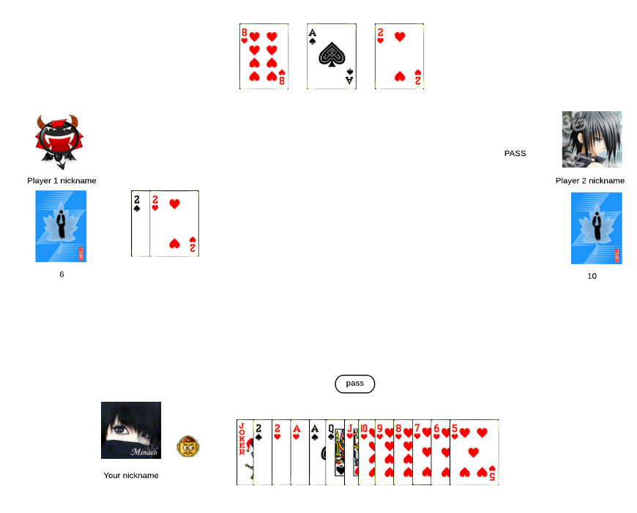
Pass in the turn

Slide 13
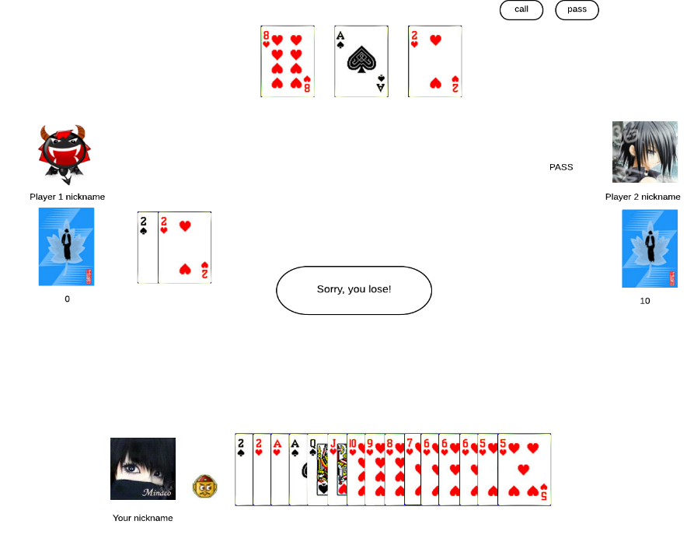
Game finish

Slide 14
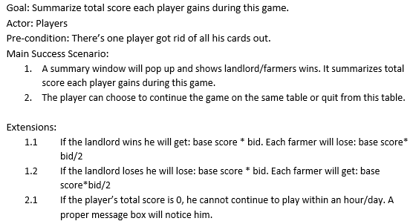
Record total scores

Slide 15
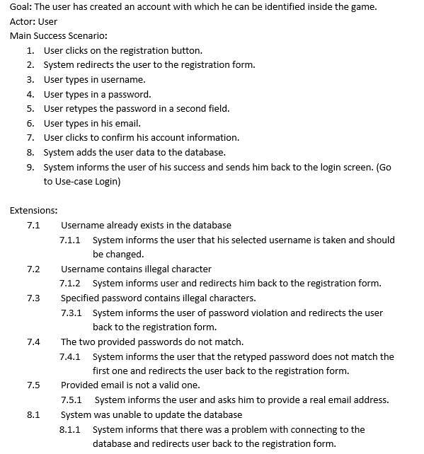
Register

Slide 16
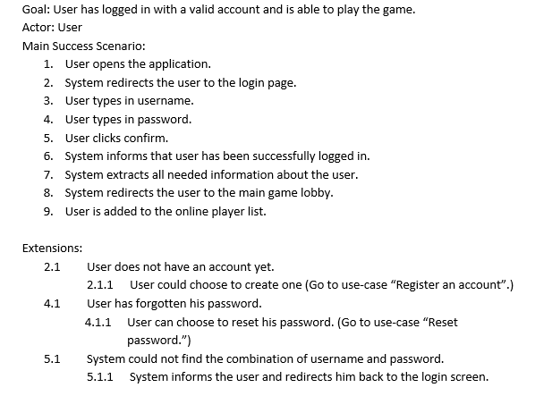
Login

Slide 17
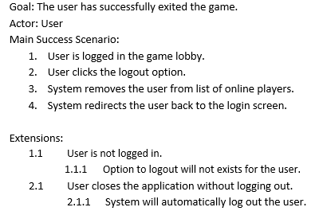
Logout

Slide 18
Non-functional requirements
Usability – The application will not be intrusive and will have an easy to understand GUI. The application’s interaction will be intuitive.

Slide 19
Non-functional requirements
Reliability – All the simulations from the software will be accurate and precise. They will provide with an ideal situation of traffic control that is not influenced by forces not stated by the client. Any outside tempering with the system will be prevented and prohibited.

Slide 20
Non-functional requirements
Maintainability – The software will be provided with error protection protocols. The software will be written in proper standards, making it easy to be accessed from third parties.

Slide 21
Non-functional requirements
Performance – This is an important aspect in any Simulation. The application will not take up unnecessary computer memory or computing time. It will match with efficiency standards allowing the simulations to run smoothly.

Slide 22
Non-functional requirements
Extensibility – We will make sure that the code is as clean as possible and structured in a nice way so that there won’t be any difficulty when adding additional features.

Slide 23
Questions?

